Slide 1

Main factors associated with hiring at UN agencies
Yousof Hajhasan 20200551
Abdulrahman Melhem 20190006
Zaid Abdullah 20200284
Omar Qandil 20200071
Mohammed Morshid 20180605
Yazeed Khaleel 20200354

Slide 2







Introduction
What is our goal?
Our research aimed to gain a deeper understanding of the acceptance process for applicants at the United Nations by analyzing recruitment data from the roster pool. We examined the data to identify potential factors that may have influenced acceptance and determine their significance.

Slide 3


Explanatory and Exploratory Data Analysis
Our study used recruitment applicants selected from the roster talent pool and analyzed various characteristics using visualization techniques such as plotting distributions. The outcome of the study found that the most relevant factors that showed results of acceptance ratio are: region, account status, and number of languages spoken fluently. The most influential factor on applicant acceptance appears to be the number of languages that applicant is fluent at.

Slide 4
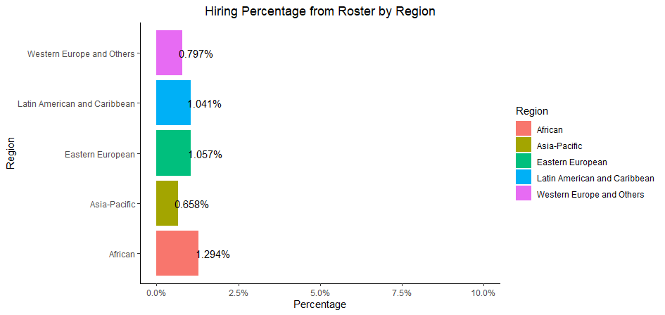
Hiring Percentage from roster by region
We evaluated the distribution of acceptance percentages among different regions. We observed that Africa had the highest hiring percentage, which was 20% higher than Eastern Europe (the second highest). Latin America and the Caribbean had similar acceptance levels, while Asia Pacific and Western Europe had the lowest percentages.

Slide 5
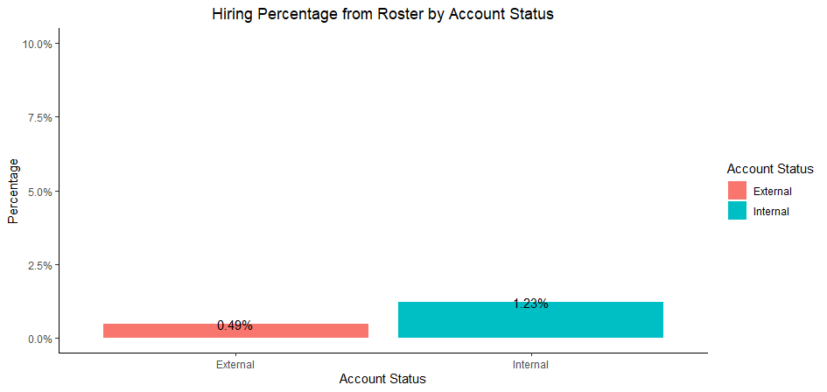
Hiring Percentage from roster by account status
We evaluated the distribution of acceptance percentages between internal and external applicants. We found that internal applicants had 2.5 times higher chances of being hired compared to external applicants.

Slide 6
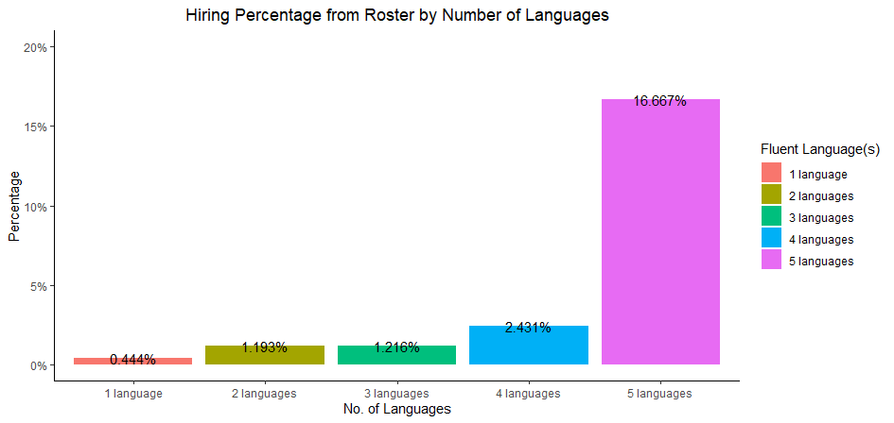
The effect of number of fluent languages on acceptance
We evaluated the distribution of the applicant's number of languages and their percentage, we found that fluency in five languages had the highest percentage, at 7 times higher than fluency in four languages. Additionally, fluency in four languages was almost twice as prevalent as fluency in three or two languages. The percentage of individuals fluent in only one language was found to be the lowest among those evaluated for fluency in multiple languages.

Slide 7
Recommendations
Based on the results of our study, we recommend that the United Nations place a greater emphasis on the number of languages fluently spoken when assessing qualifications. Our findings indicate that being fluent in multiple languages is positively correlated with a higher acceptance rate.
In order to improve the acceptance rate, the United Nations should consider offering language classes or language-specific training programs for applicants to increase their fluency levels.
Additionally, regular monitoring and analysis of acceptance rates and identifying new trends or factors that might influence the acceptance process is recommended to stay updated and make informed decisions when it comes to recruitment process.

